Slide 1
Cache Memory
Adapted from lectures notes of Dr. Patterson and Dr. Kubiatowicz of UC Berkeley

Slide 2
Revisiting Memory Hierarchy
Facts
  Big is slow
  Fast is small
Increase performance by having “hierarchy” of memory subsystems
“Temporal Locality” and “Spatial Locality” are big ideas

Slide 3
Revisiting Memory Hierarchy
Terms
  Cache Miss
  Cache Hit
  Hit Rate
  Miss Rate
  Index, Offset and Tag

Slide 4
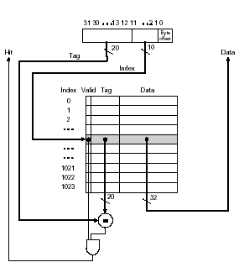
Direct Mapped Cache

Slide 5
Direct Mapped Cache [contd…]
What is the size of cache ?
4K
If I read
0000 0000 0000 0000 0000 0000 1000 0001
What is the index number checked ?
32
If the number was found, what are the inputs to comparator ?

Slide 6
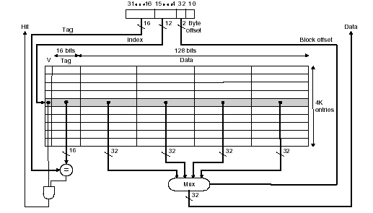
Direct Mapped Cache [contd…]
Taking advantage of spatial locality, we read 4 bytes at a time

Slide 7
Direct Mapped Cache [contd…]
Advantage
  Simple
  Fast
Disadvantage
  Mapping is fixed !!!

Slide 8
Associative Caches
Block 12 placed in 8 block cache:
  Fully associative, direct mapped, 2-way set associative
  S.A. Mapping = Block Number Modulo Number Sets
Fully associative:
block 12 can go anywhere
Direct mapped:
block 12 can go only into block 4 (12 mod 8)
Set associative:
block 12 can go anywhere in set 0 (12 mod 4)
Block
no.
0 1 2 3 4 5 6 7
Block
no.
0 1 2 3 4 5 6 7
Block
no.
0 1 2 3 4 5 6 7
Set
0
Set
1
Set
2
Set
3
Block-frame address
Block
no.
1 1 1 1 1 1 1 1 1 1 2 2 2 2 2 2 2 2 2 2 3 3
0 1 2 3 4 5 6 7 8 9 0 1 2 3 4 5 6 7 8 9 0 1 2 3 4 5 6 7 8 9 0 1

Slide 9
Set Associative Cache
N-way set associative: N entries for each Cache Index
  N direct mapped caches operates in parallel
Example: Two-way set associative cache
  Cache Index selects a “set” from the cache
  The two tags in the set are compared to the input in parallel
  Data is selected based on the tag result
Cache Index
Valid
Cache Tag
Cache Data
Cache Data
Cache Tag
Valid
Cache Block 0
Cache Block 0
:
:
:
:
:
:
Adr Tag
Compare
Sel1
1
Mux
0
Sel0
Compare
OR
Cache Block
Hit

Slide 10
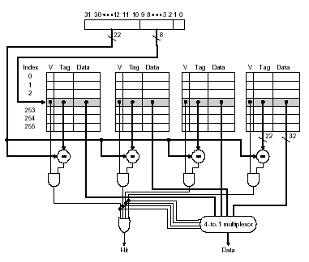
Example: 4-way set associative Cache
What is the cache size in this case ?

Slide 11
Disadvantages of Set Associative Cache
N-way Set Associative Cache versus Direct Mapped Cache:
  N comparators vs. 1
  Extra MUX delay for the data
  Data comes AFTER Hit/Miss decision and set selection
In a direct mapped cache, Cache Block is available BEFORE Hit/Miss:
Cache Index
Valid
Cache Tag
Cache Data
Cache Data
Cache Tag
Valid
Cache Block 0
Cache Block 0
:
:
:
:
:
:
Adr Tag
Compare
Sel1
1
Mux
0
Sel0
Compare
OR
Cache Block
Hit

Slide 12
Fully Associative Cache
Fully Associative Cache
  Forget about the Cache Index
  Compare the Cache Tags of all cache entries in parallel
  Example: Block Size = 32 B blocks, we need N 27-bit comparators
By definition: Conflict Miss = 0 for a fully associative cache
31
4
0
Cache Tag (27 bits long)
Byte Select
Ex: 0x01
Cache Tag
Valid Bit
Cache Data
=
Byte 31
:
Byte 1
Byte 0
=
Byte 63
:
Byte 33
Byte 32
=
=
:
:
:
=

Slide 13
Cache Misses
Compulsory (cold start or process migration, first reference): first access to a block
  “Cold” fact of life: not a whole lot you can do about it
  Note: If you are going to run “billions” of instruction, Compulsory Misses are insignificant
Capacity:
  Cache cannot contain all blocks access by the program
  Solution: increase cache size
Conflict (collision):
  Multiple memory locations mapped
  to the same cache location
  Solution 1: increase cache size
  Solution 2: increase associativity
Coherence (Invalidation): other process (e.g., I/O) updates memory

Slide 14
Design Options at Constant Cost
Direct Mapped
N-way Set Associative
Fully Associative
Cache Size
Big
Medium
Small
Compulsory Miss
Same
Same
Same
Conflict Miss
High
Medium
Zero
Capacity Miss
Low
Medium
High
Coherence Miss
Same
Same
Same

Slide 15
Four Questions for Cache Design
Q1: Where can a block be placed in the upper level?
(Block placement)
Q2: How is a block found if it is in the upper level?
(Block identification)
Q3: Which block should be replaced on a miss?
(Block replacement)
Q4: What happens on a write?
(Write strategy)

Slide 16
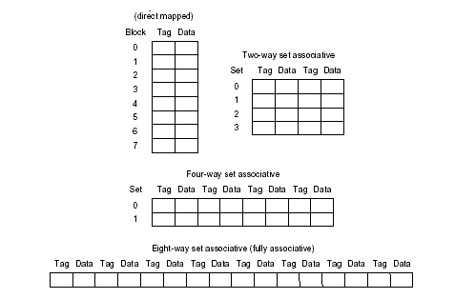
Where can a block be placed in the upper level?
Direct Mapped
Set Associative
Fully Associative

Slide 17
How is a block found if it is in the upper level?
Block Address
Block
offset
Tag
Index
Set Select
Data Select
Direct indexing (using index and block offset), tag compares, or combination
Increasing associativity shrinks index, expands tag

Slide 18
Which block should be replaced on a miss?
Easy for Direct Mapped
Set Associative or Fully Associative:
  Random
  LRU (Least Recently Used)
Associativity: 2-way 4-way 8-way
Size LRU Random LRU Random LRU Random
16 KB 5.2% 5.7% 4.7% 5.3% 4.4% 5.0%
64 KB 1.9% 2.0% 1.5% 1.7% 1.4% 1.5%
256 KB 1.15% 1.17% 1.13% 1.13% 1.12% 1.12%

Slide 19
What happens on a write?
Write through—The information is written to both the block in the cache and to the block in the lower-level memory.
Write back—The information is written only to the block in the cache. The modified cache block is written to main memory only when it is replaced.
  is block clean or dirty?
Pros and Cons of each?
  WT: read misses cannot result in writes
  WB: no writes of repeated writes
WT always combined with write buffers so that don’t wait for lower level memory

Slide 20
Two types of Cache
PC
Instruction Cache
Data Cache
I -Cache
miss
IR
IRex
A
B
invalid
IRm
R
D Cache
IRwb
T
Miss

Slide 21
Improving Cache Performance
Reduce Miss Rate
  Associativity
  Victim Cache
  Compiler Optimizations
Reduce Miss Penalty
  Faster DRAM
  Write Buffers
Reduce Hit Time

Slide 22
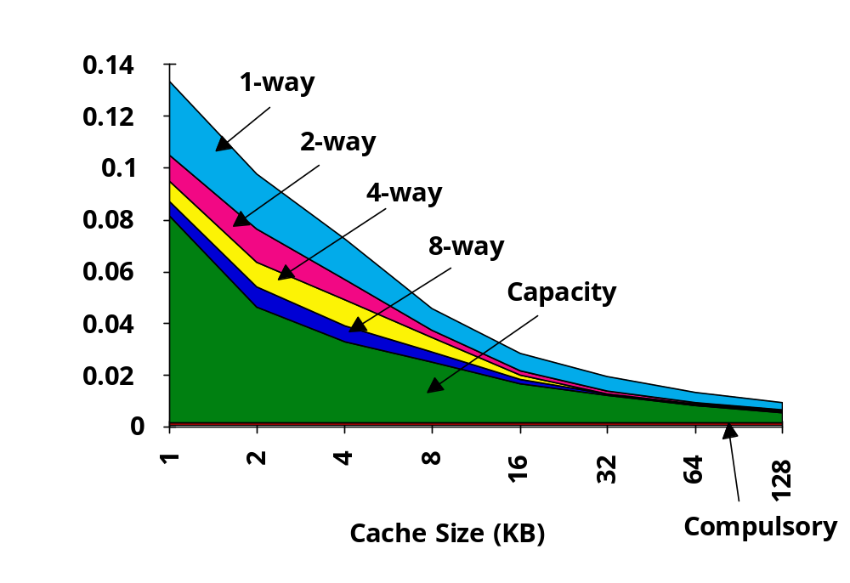
Reduce Miss Rate

Slide 23
Reduce Miss Rate [contd…]
miss rate 1-way associative cache size X
= miss rate 2-way associative cache size X/2
Conflict

Slide 24
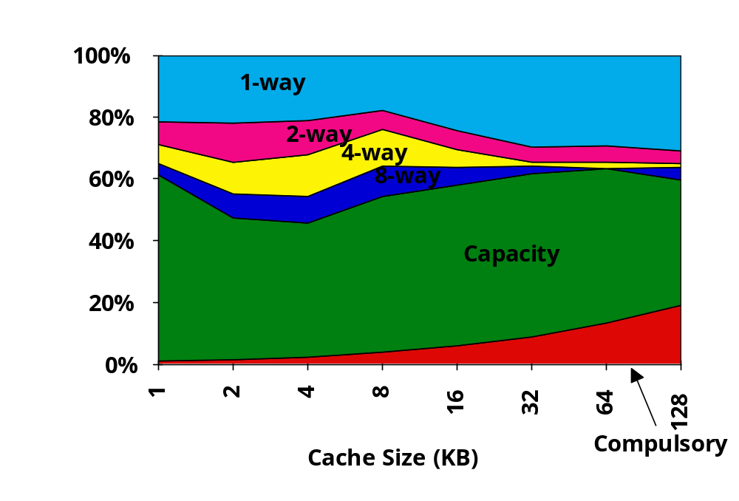
3Cs Comparison
Conflict

Slide 25
Compiler Optimizations
Compiler Optimizations to reduce miss rate
  Loop Fusion
  Loop Interchange
  Merge Arrays

Slide 26
Reducing Miss Penalty
Faster RAM memories
  Driven by technology and cost !!!
  Eg: CRAY uses only SRAM

Slide 27
Reduce Hit Time
Lower Associativity
  Add L1 and L2 caches
  L1 cache is small => Hit Time is critical
  L2 cache has large => Miss Penalty is critical

Slide 28
Reducing Miss Penalty [contd…]
Cache
Processor
DRAM
Write Buffer
A Write Buffer is needed between the Cache and Memory
  Processor: writes data into the cache and the write buffer
  Memory controller: write contents of the buffer to memory
Write buffer is just a FIFO:

Slide 29
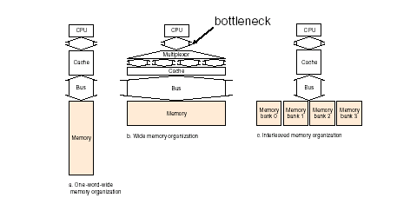
Designing the Memory System to Support Caches
Eg: 1 clock cycle to send address and data, 15 for each DRAM access
Case 1: (Main memory of one word)
1 + 4 x 15 + 4 x 1 = 65 clk cycles, bytes/clock = 16/65 = 0.25
Case 2: (Main memory of two words)
1 + 2 x 15 + 2 x 1 = 33 clk cycles, bytes/clock = 16/33 = 0.48
Case 3: (Interleaved memory)
1 + 1 x 15 + 4 x 1 = 20 clk cycles, bytes/clock = 16/20 = 0.80

Slide 30
The possible R/W cases
Read Hit
  Good for CPU !!!
Read Miss
  Stall CPU, fetch, Resume
Write Hit
  Write Through
  Write Back
Write Miss
  Write entire block into memory, Read into cache

Slide 31
Performance
CPU time = (CPU execution clock cycles +
Memory stall clock cycles) x clock cycle time
Memory stall clock cycles =
(Reads x Read miss rate x Read miss penalty +
Writes x Write miss rate x Write miss penalty)
Memory stall clock cycles =
Memory accesses x Miss rate x Miss penalty
Different measure: AMAT
Average Memory Access time (AMAT) =
Hit Time + (Miss Rate x Miss Penalty)
Note: memory hit time is included in execution cycles.

Slide 32
Performance [contd…]
Suppose a processor executes at
  Clock Rate = 200 MHz (5 ns per cycle)
  Base CPI = 1.1
  50% arith/logic, 30% ld/st, 20% control
Suppose that 10% of memory
operations get 50 cycle miss penalty
Suppose that 1% of instructions get same miss penalty
CPI = Base CPI + average stalls per instruction 1.1(cycles/ins) +
[ 0.30 (DataMops/ins)
x 0.10 (miss/DataMop) x 50 (cycle/miss)] +
[ 1 (InstMop/ins)
x 0.01 (miss/InstMop) x 50 (cycle/miss)]
= (1.1 + 1.5 + .5) cycle/ins = 3.1
58% of the time the proc is stalled waiting for memory!
AMAT=(1/1.3)x[1+0.01x50]+(0.3/1.3)x[1+0.1x50]=2.54

Slide 33
Summary
The Principle of Locality:
  Program likely to access a relatively small portion of the address space at any instant of time.
    Temporal Locality: Locality in Time
    Spatial Locality: Locality in Space
Three (+1) Major Categories of Cache Misses:
  Compulsory Misses: sad facts of life. Example: cold start misses.
  Conflict Misses: increase cache size and/or associativity.
  Nightmare Scenario: ping pong effect!
  Capacity Misses: increase cache size
  Coherence Misses: Caused by external processors or I/O devices
Cache Design Space
  total size, block size, associativity
  replacement policy
  write-hit policy (write-through, write-back)
  write-miss policy

Slide 34
Summary [contd…]
Cache Size
Associativity
Several interacting dimensions
  cache size
  block size
  associativity
  replacement policy
  write-through vs write-back
  write allocation
The optimal choice is a compromise
  depends on access characteristics
    workload
    use (I-cache, D-cache, TLB)
  depends on technology / cost
Simplicity often wins
Block Size
Bad
Good
Factor A
Factor B
Less
More

